Slide 1
CEGE0004: Machine Learning for Data Science Lecture 3: Instance-Based Learning Dr. Aldo Lipani

Slide 2
Instance-Based Learning
Hypothesis space:
Deterministic
Discrete and continuous features
Discrete and continuous target functions
Inductive Bias:
Instances are classified based on similar instances.
Learning algorithm:
Lazy
Widely used algorithms:
K-nearest neighbors
Collaborative filtering
Support Vector Machines

Slide 3
Instance-Based Learning
Store the training examples somewhere.
When a new instance needs to be classified, relate this to the stored examples.
Nearest neighbor:
Given a new instance, locate the nearest training example then estimate the new instance with it.
K-Nearest neighbors:
If the target function is discrete: given a new instance, take a vote among its k nearest neighbors.
If the target value is real-valued, given a new instance, take the mean of its k-nearest neighbors.
Pros:
Training is fast
Learn complex target functions
Don't lose information
Cons:
Slow at query time
Lots of storage required
Easily fooled by irrelevant attributes

Slide 4
Nearest Neighbor
When training:
training_examples.append((x, y))
When classifying:
y_pred = None min_score = float('inf') # find closest example for x, y in self.training_examples: score = self.distance(x_q, x) if score < min_score: min_score = score y_pred = y

Slide 5
Distance Measures
Numeric Features:
L^{n}-Norm
Cosine distance
Symbolic Features:
Hamming/Overlap
Value difference measure (VDM)
Distances encode knowledge.

Slide 6
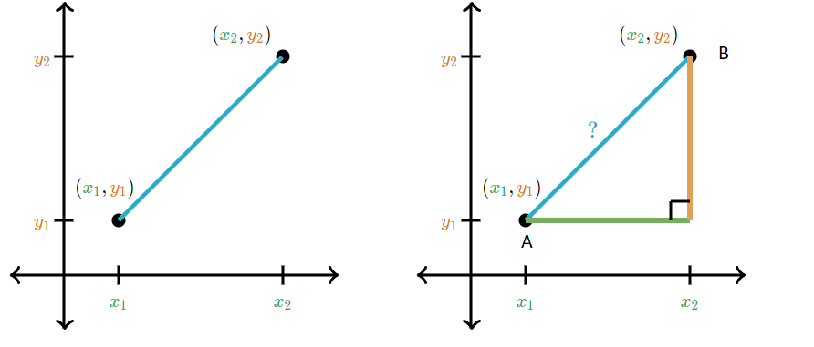
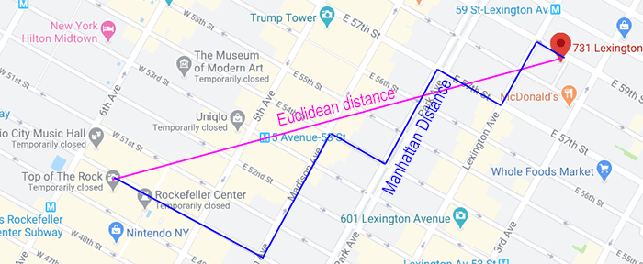

L^{n}-Norm
Given two vectors $x_{1}$and $x_{2}$, their L^{n}-norm is defined as:
If $n=2$, this is also known as Euclidean distance:
If $n=1$, this is also known as Taxicab or Manhattan distance:

Slide 7
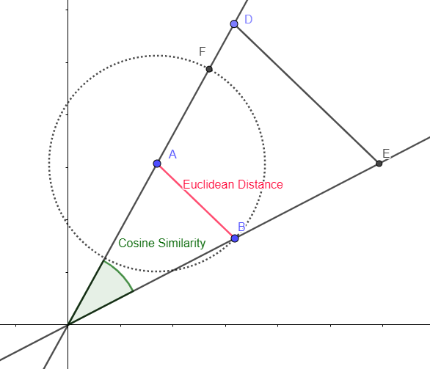
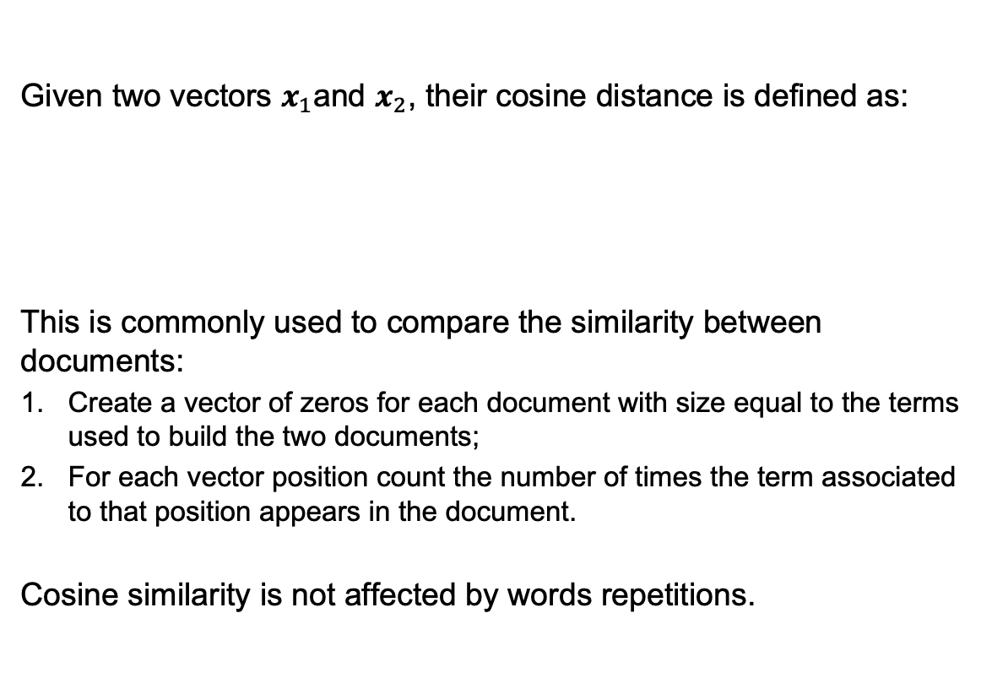
Cosine Distance
Given two vectors $x_{1}$and $x_{2}$, their cosine distance is defined as:
This is commonly used to compare the similarity between documents:
Create a vector of zeros for each document with size equal to the terms used to build the two documents;
For each vector position count the number of times the term associated to that position appears in the document.
Cosine similarity is not affected by words repetitions.

Slide 8
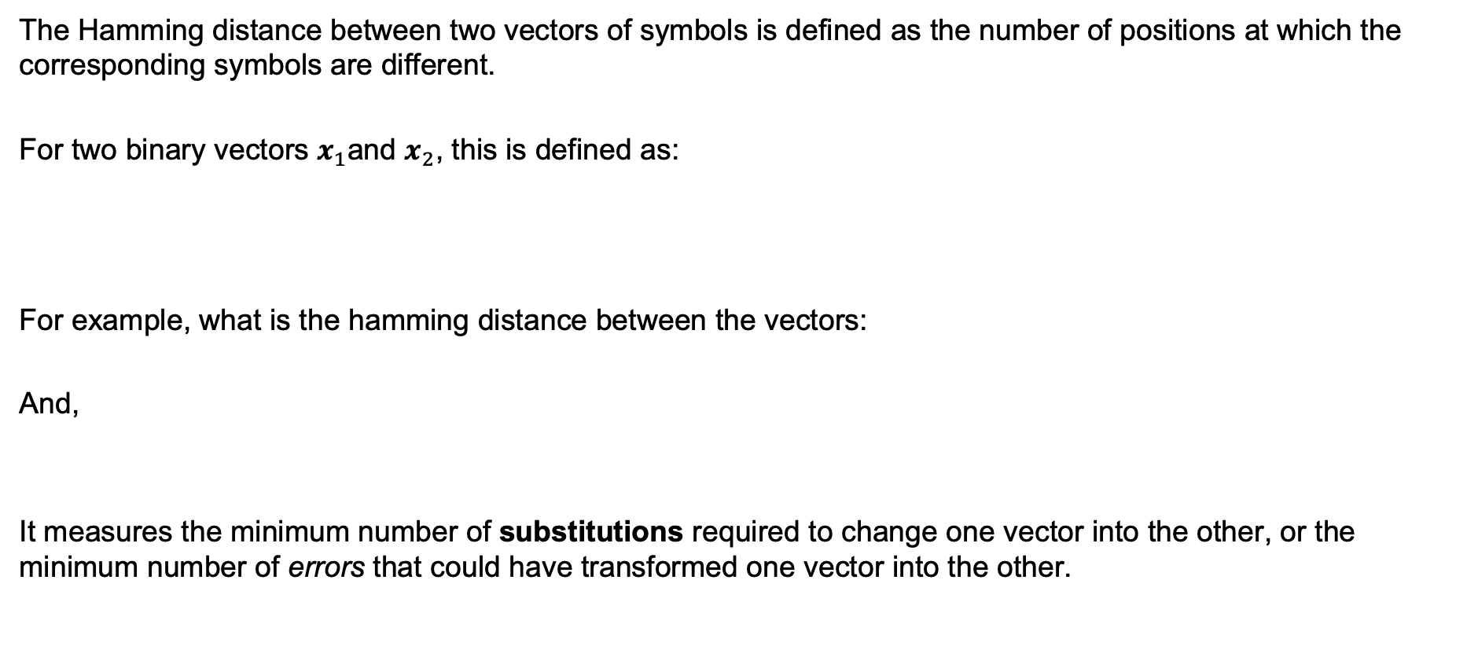
Hamming Distance
The Hamming distance between two vectors of symbols is defined as the number of positions at which the corresponding symbols are different.
For two binary vectors $x_{1}$and $x_{2}$, this is defined as:
For example, what is the hamming distance between the vectors:
And,
It measures the minimum number of substitutions required to change one vector into the other, or the minimum number of errors that could have transformed one vector into the other.

Slide 9
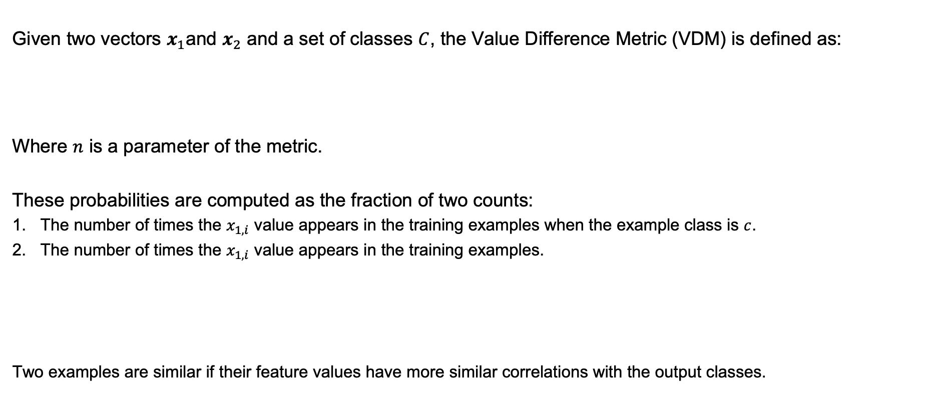
Value Difference Metric
Given two vectors $x_{1}$and $x_{2}$ and a set of classes $C$, the Value Difference Metric (VDM) is defined as:
Where $n$ is a parameter of the metric.
These probabilities are computed as the fraction of two counts:
The number of times the $x_{1,i}$ value appears in the training examples when the example class is $c$.
The number of times the $x_{1,i}$ value appears in the training examples.
Two examples are similar if their feature values have more similar correlations with the output classes.

Slide 10
k-Nearest Neighbors
When training:
training_examples.append((x, y))
When classifying:
res = [] # compute distance for each training example for x, y in self.training_examples: score = self.distance(x_q, x) # store outcome and score res.append((y, score))
# sort by score in descending order res.sort(reverse=True, key = itemgetter(1))
# select the first k and return only the outcome res = [y for y, score in res[:k]]
# take the most common outcome
mode(res)

Slide 11

Decision Boundary
The decision boundary is formed by Voronoi cells: All points closer to $x$ than to any other instance.
Region of class $c$ is formed by the union of the Voronoi cells of instances of $c$.

Slide 12
Distance-Weighted k-Nearest Neighbors
res = [] # compute distance for each training example for x, y in self.training_examples: score = self.distance(x_q, x) weight = self.weight(x_q, x)
# store outcome and score res.append((y, score, weight))
# sort by score in descending order res.sort(reverse=True, key = itemgetter(1))
norm_weight = sum([weight for y, score, weight in res[:k]]) # select the first k and return only the outcome res = [y, score * weight / norm_weight for y, score, weight in res[:k]]
# take the most outcome that scores the highest
score_y = defaultdict(float)
for y, score in res:
score_y[y] += score
max(score.items(), key=itemgetter(1))[0]
Now it makes sense to use all training examples. res[:k] -> res

Slide 13
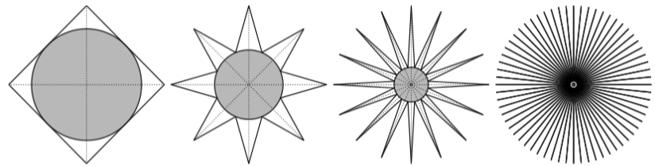
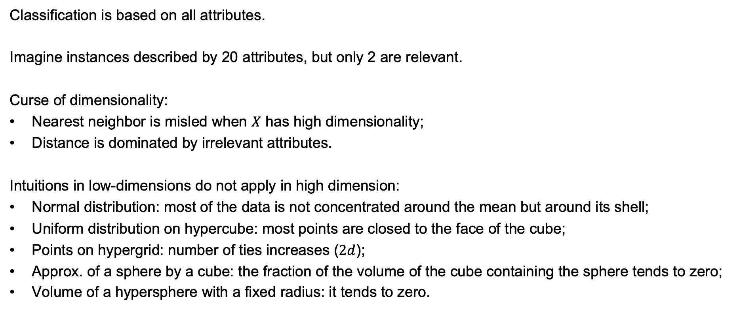
Curse of Dimensionality
Classification is based on all attributes.
Imagine instances described by 20 attributes, but only 2 are relevant.
Curse of dimensionality:
Nearest neighbor is misled when $X$ has high dimensionality;
Distance is dominated by irrelevant attributes.
Intuitions in low-dimensions do not apply in high dimension:
Normal distribution: most of the data is not concentrated around the mean but around its shell;
Uniform distribution on hypercube: most points are closed to the face of the cube;
Points on hypergrid: number of ties increases ($2d$);
Approx. of a sphere by a cube: the fraction of the volume of the cube containing the sphere tends to zero;
Volume of a hypersphere with a fixed radius: it tends to zero.

Slide 14
Feature Selection
To mitigate the curse of dimensionality we could:
Weight each attribute differently when calculating the distance between two instances:
stretching the axes in the Euclidean space, shortening the axes that correspond to less relevant attributes and lengthening the axes that correspond to more relevant attributes;
to determine these weights, we can use cross-validation.
Eliminate some attributes also via cross-validation.

Slide 15
Optimize Performance and Memory
More efficient retrieval with kd-trees: instances are stored at the leaves of a tree, with nearby instances stored at the same or nearby nodes.
More efficient similarity comparison:
Use cheap approximations to filter out most instances;
Use expensive measure on the rest.
Form prototypes.
Edited k-NN: Remove instances that don't affect frontier.

Slide 16
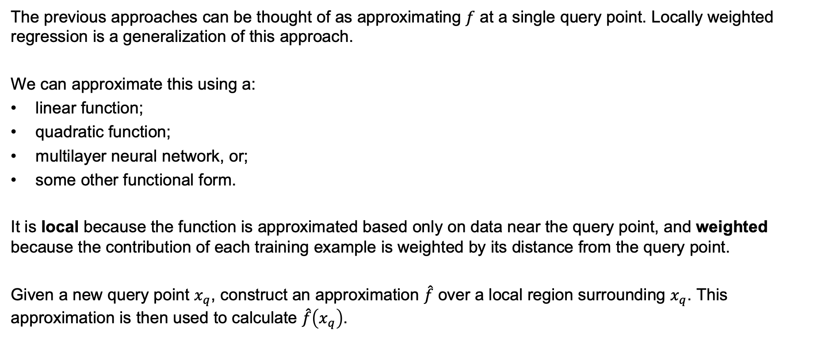
Locally Weighted Regression
The previous approaches can be thought of as approximating $f$ at a single query point. Locally weighted regression is a generalization of this approach.
We can approximate this using a:
linear function;
quadratic function;
multilayer neural network, or;
some other functional form.
It is local because the function is approximated based only on data near the query point, and weighted because the contribution of each training example is weighted by its distance from the query point.
Given a new query point $x_{q}$, construct an approximation $\hat{f}$ over a local region surrounding $x_{q}$. This approximation is then used to calculate $\hat{f}\left(x_{q}\right)$.

Slide 17
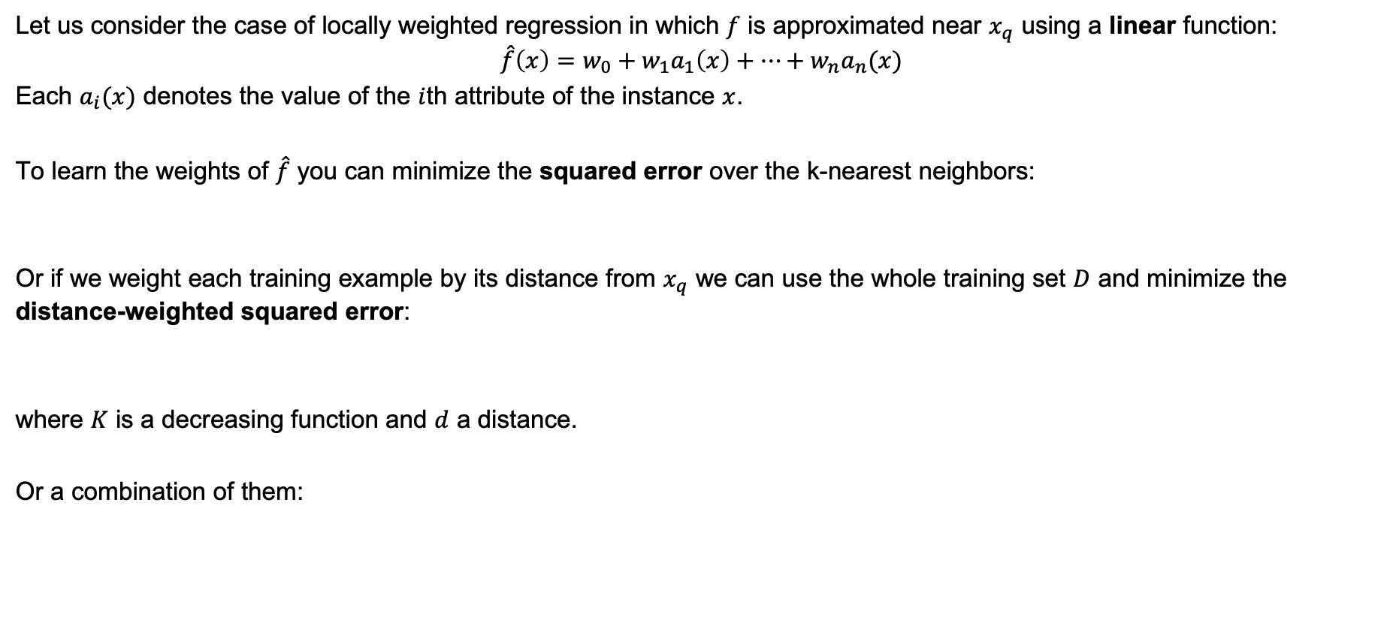
Locally Weighted Linear Regression
Let us consider the case of locally weighted regression in which $f$ is approximated near $x_{q}$ using a linear function:
$$\hat{f}\left(x\right)=w_{0}+w_{1}a_{1}\left(x\right)+…+w_{n}a_{n}(x)$$
Each $a_{i}(x)$ denotes the value of the $i$th attribute of the instance $x$.
To learn the weights of $\hat{f}$ you can minimize the squared error over the k-nearest neighbors:
Or if we weight each training example by its distance from $x_{q}$ we can use the whole training set $D$ and minimize the distance-weighted squared error:
where $K$ is a decreasing function and $d$ a distance.
Or a combination of them:

Slide 18
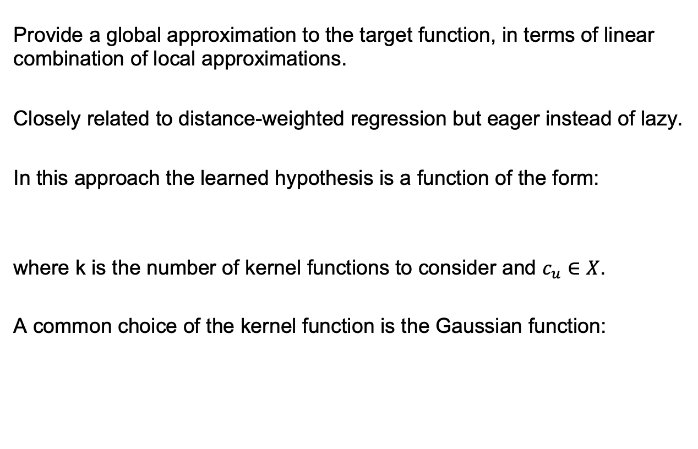
Radial Basis Function Networks
Provide a global approximation to the target function, in terms of linear combination of local approximations.
Closely related to distance-weighted regression but eager instead of lazy.
In this approach the learned hypothesis is a function of the form:
where k is the number of kernel functions to consider and $c_{u}∈X$.
A common choice of the kernel function is the Gaussian function:

Slide 19
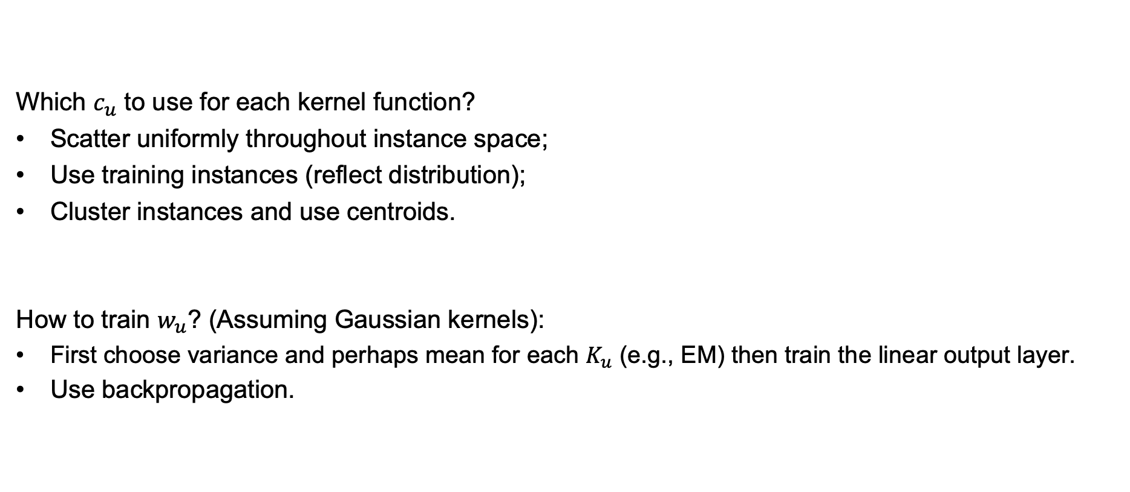
Training Radial Basis Function Networks
Which $c_{u}$ to use for each kernel function?
Scatter uniformly throughout instance space;
Use training instances (reflect distribution);
Cluster instances and use centroids.
How to train $w_{u}$? (Assuming Gaussian kernels):
First choose variance and perhaps mean for each $K_{u}$ (e.g., EM) then train the linear output layer.
Use backpropagation.

Slide 20
Lazy vs. Eager Learning
Lazy learners create many local approximations.
Wait for query before generalizing:
k-nearest neighbor, …
Eager learners must create global approximation.
Generalize before seeing query
ID3, C4.5, Naïve Bayes, neural networks, …
If they use same hypotheses space, lazy learners can represent more complex functions. For example, think about the case of linear functions.

Slide 21
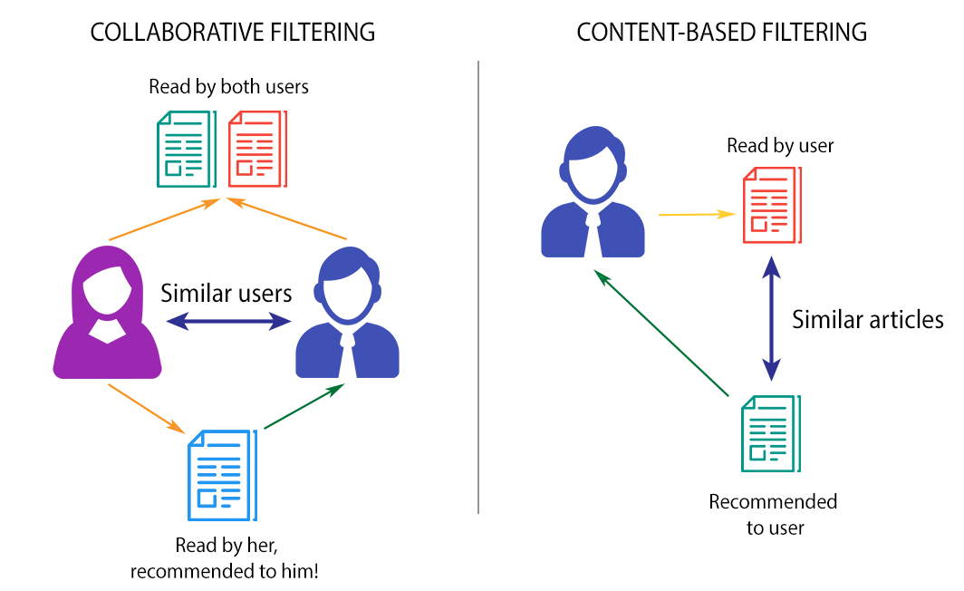
Collaborative Filtering
Predict whether someone will like a product.
Look at what you bought before and try to predict what you will buy next? (Not working)
Collaborative Filtering:
Look at what similar users liked?
Similar users like and dislike similar products.

Slide 22
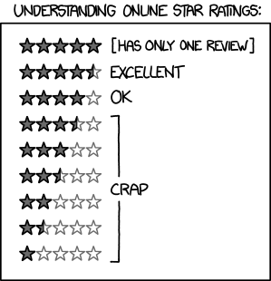

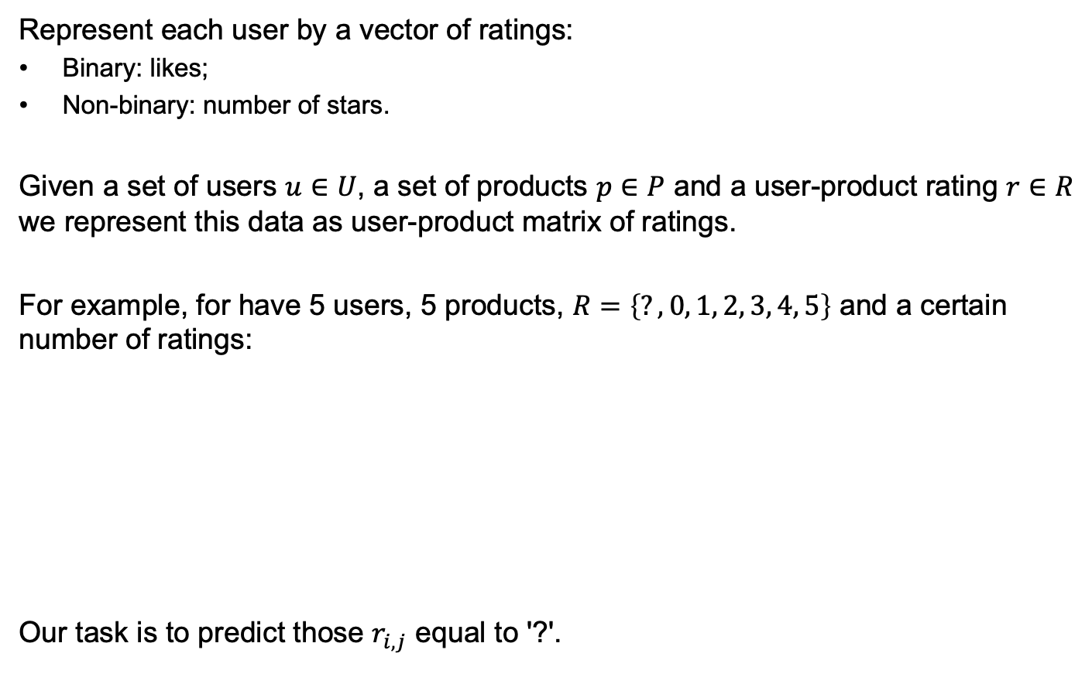
Collaborative Filtering
Represent each user by a vector of ratings:
Binary: likes;
Non-binary: number of stars.
Given a set of users $u∈U$, a set of products $p∈P$ and a user-product rating $r∈R$ we represent this data as user-product matrix of ratings.
For example, for have 5 users, 5 products, $R=\left\{?, 0, 1, 2, 3, 4, 5\right\}$ and a certain number of ratings:
Our task is to predict those $r_{i,j}$ equal to '?'.
https://xkcd.com/1098/

Slide 23
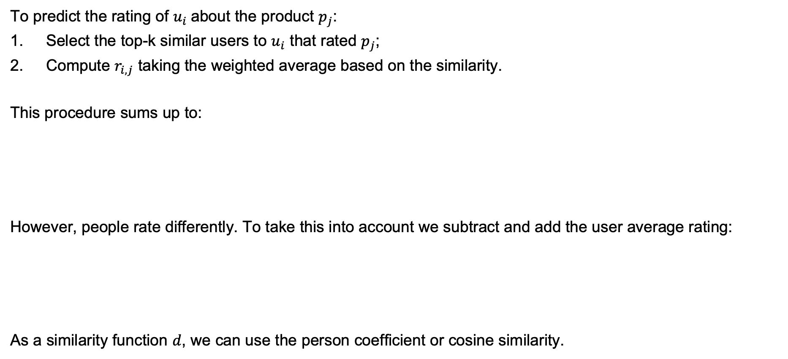
Collaborative Filtering
To predict the rating of $u_{i}$about the product $p_{j}$:
Select the top-k similar users to $u_{i}$ that rated $p_{j}$;
Compute $r_{i,j}$ taking the weighted average based on the similarity.
This procedure sums up to:
However, people rate differently. To take this into account we subtract and add the user average rating:
As a similarity function $d$, we can use the person coefficient or cosine similarity.

Slide 24
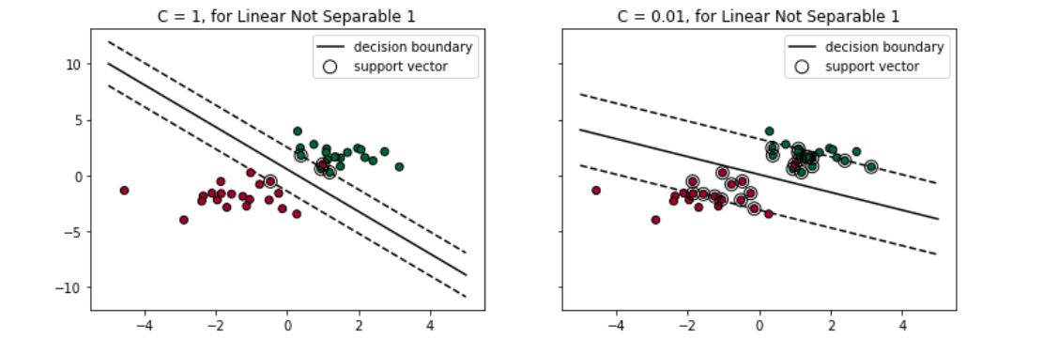
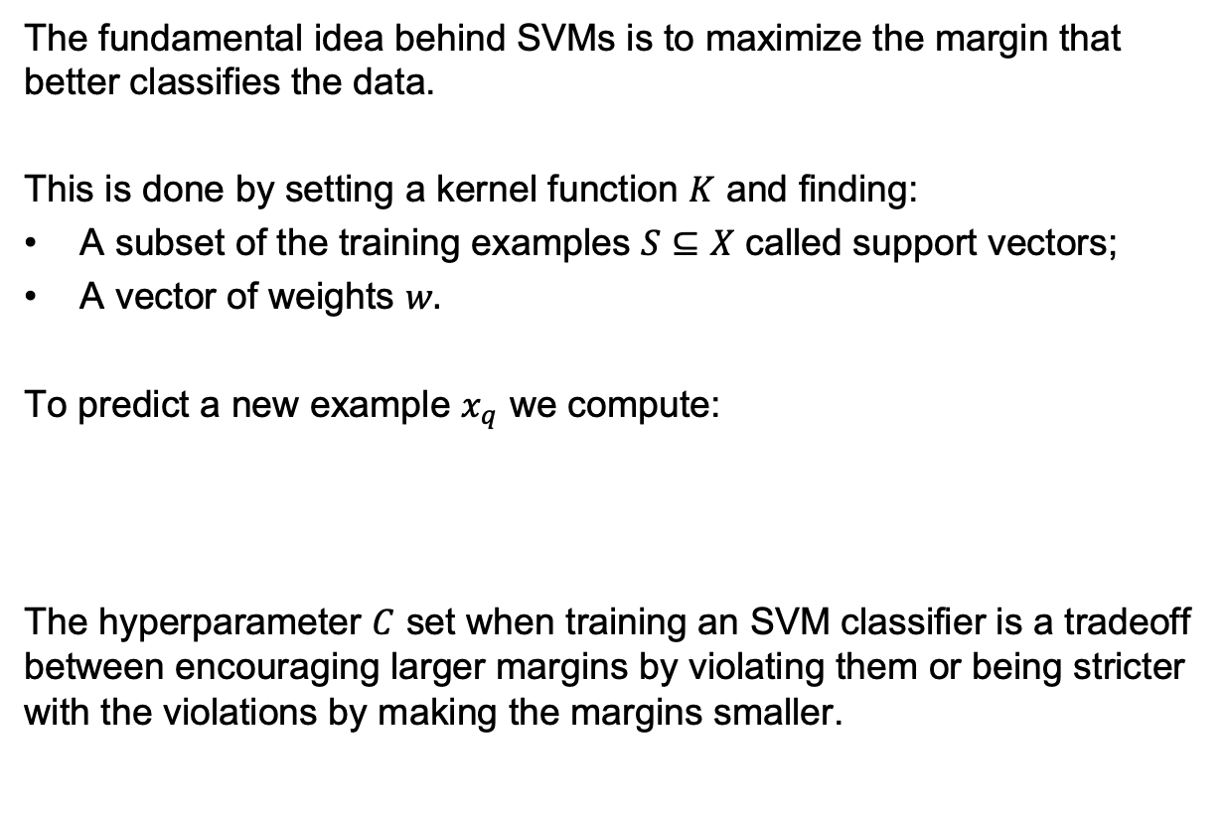
Support Vector Machines
The fundamental idea behind SVMs is to maximize the margin that better classifies the data.
This is done by setting a kernel function $K$ and finding:
A subset of the training examples $S⊆X$ called support vectors;
A vector of weights $w.$
To predict a new example $x_{q}$ we compute:
The hyperparameter $C$ set when training an SVM classifier is a tradeoff between encouraging larger margins by violating them or being stricter with the violations by making the margins smaller.

